Slide 1
NPCI Voice Based Payments Hackathon
Made By-
Prathamesh Sahasrabhojane.
ssahasrabhojane@gmail.com

Slide 2
Brief Explanation of Idea
Voice Coin is a multi-platform mobile application developed for encouraging digital payments by providing easy to use voice based interface.
To ensure that the customer can do the payments without needing to switch to other platform than UPI, We have built the solution in such a way that the current UPI platforms which are popular among the users can be used.
This solution solves the problem of going through manual process of filling up the details manually.
It can work with UPI applications like – Google Pay, Paytm, PhonePe, etc.

Slide 3
What problem you are solving:
Security issues and lack of customer trust are among the top obstacles to the adoption of voice payments. Voice payments will succeed only when we develop and implement advanced authentication and protection methods.
We are solving above mentioned problem by providing a multiplatform mobile solution, Which doesn’t require any other infrastructure & it is easily usable by just installing it in customers mobile devices.
It can be deployed as a product as soon as possible.
This solution is easily acceptable and efficient for the customer.

Slide 4
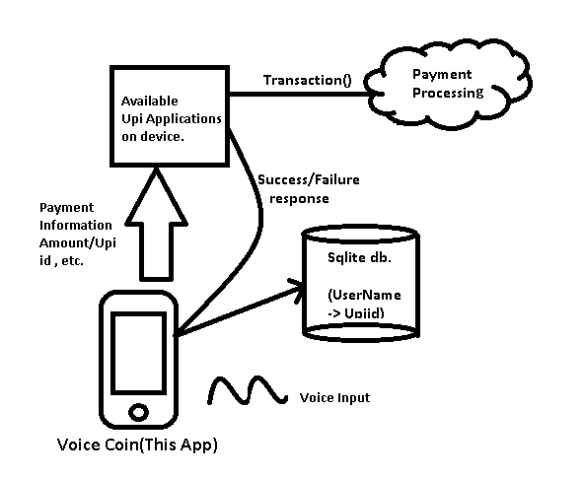
Technical Architecture/ POC

Slide 5
In previous slide the system diagram is shown about how the basic functionality of application works.
Device – The device receives voice commands by the user
(Example – Pay 100 Rupees to Prathamesh).
The Voice Coin application will detect the intent and essential data in order to make a payment. Then the request for the UPI payment will be forwarded to UPI applications as per users default choice. The UPI id will be confirmed before the transaction so it automatically add 2 step confirmation for the transaction.
The Contacts and their UPI id will be stored in SQLite database as reference contacts for the payment. Then the UPI id can be accessed by the name of the person/contact.

Slide 6
Technology/Tool Stack
Technology used –
Mobile Platform (for now)
- Android
- IOS
Development Technology –
Flutter Development Kit.
SQL
Tools –
VS Code , Android Debugger, Android Studio.

Slide 7
What you have tried to build:
We have built a mobile application named Voice Coin. It is a multi-platform mobile application developed for encouraging digital payments by providing easy to use voice-based interface.
It ensures that the customer can do the payments without needing to switch to other platform than UPI, We have built the solution in such a way that the current UPI platforms which are popular among the users can be used.
Voice Coin solves the problem of going through manual process of filling up the details manually for performing a digital transaction.

Slide 8
Provide a brief summary of the application
It has a Basic Interface including option to choose default UPI Platform.
After we give voice command it initiates the transaction to identify the user’s intent & respond accordingly.
It will ask for all essential details before performing the transactions.
Then by validating the payment information it will carry out the transaction.

Slide 9
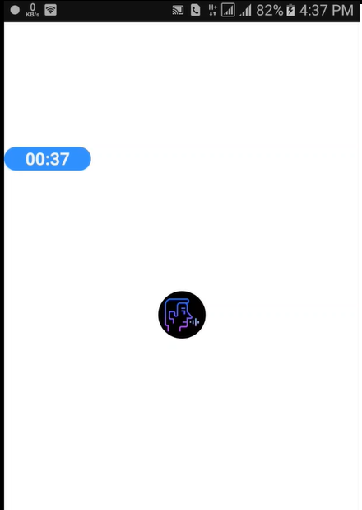
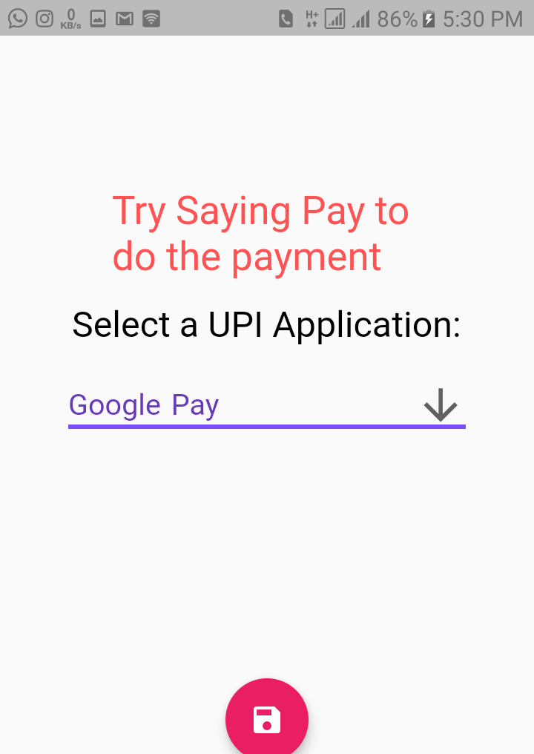
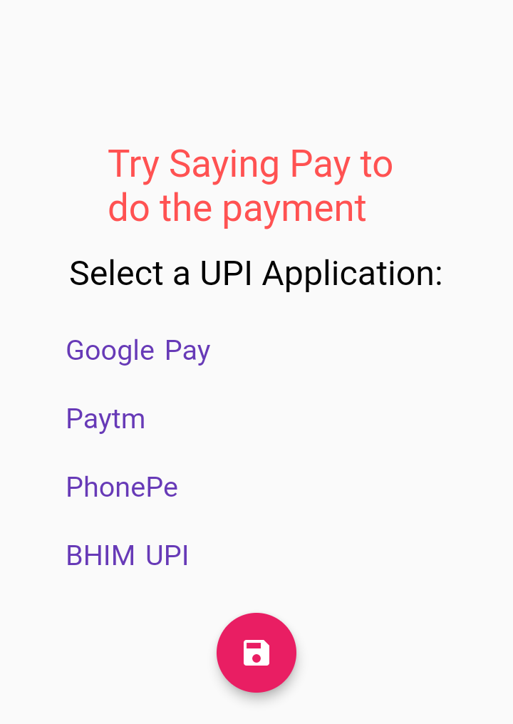
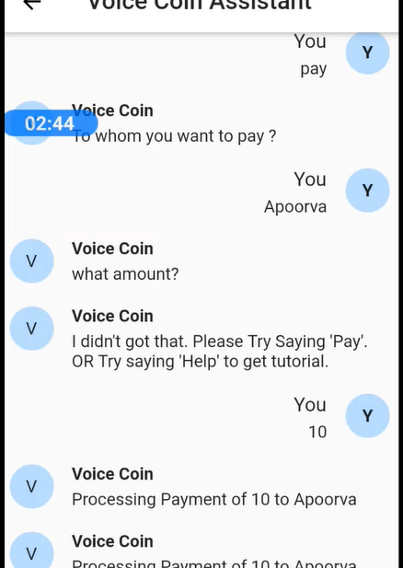
Prototype Demo(Video/Screenshots)

Slide 10
Why your Application/solution should be considered for the final round
I think I should attend this round because my solution is simple yet easy to apply.
VoiceCoin provides simple commands to perform the voice-based payment easily.
And as I am a student who works on such project in free time as a passion. I would be glad to be a part of this Hackathon.

Slide 11
Thank You

